Slide 1

Shri Chhatrapati Shivaji Maharaj College of Engineering
“DEPARTMENT OF COMPUTER ENGINEERING”
(2023-24)
“ Smart Plate Access Control ”
By,
Vinay Pandey Prachi Katkar Janhavi Hirwe
Under the guidance of,
Prof. Ghadage R.A.

Slide 2
“Smart Plate Access Control”
Unlocking the future of parking: Where AI meets access control

Slide 3


INTRODUCTION
In today's urban environments, efficient parking management is crucial. Congested parking lots, manual ticketing systems, and security concerns have prompted the need for a more advanced approach.
The smart Plate Access control System addresses these challenges by harnessing the power of technology and automation. It provides a seamless and convenient parking experience for both operators and users.

Slide 4
PROBLEM STATEMENT
To address the growing challenges of efficient parking access control and enhance security, there is a need for a reliable and technologically advanced solution. This solution should accurately recognize vehicle number plates, verify permissions, and automate the access process, while also incorporating facial recognition for added security.

Slide 5
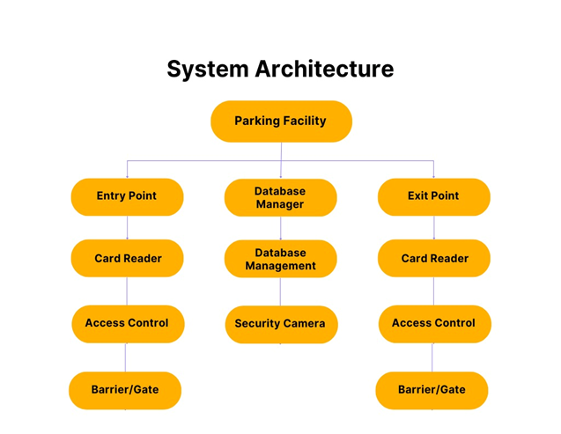
EXISTING SYSTEM
Manual verification with swipe cards/tickets.
Identification of vehicle using number plate by human.

Slide 6

PROPOSED SYSTEM
The aim is to create a seamless and secure access control solution that enhances parking efficiency and ensures only authorized vehicles can enter designated parking areas.
Advantages
Disadvantages
Enhancing Security
Efficiency
Customization
Initial Cost
Maintenance
Expansion Cost

Slide 7


Slide 8
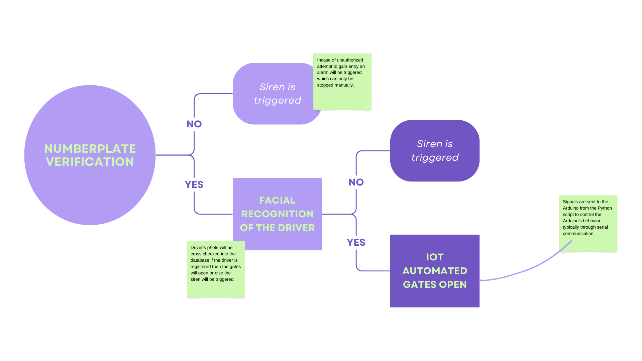
SYSTEM ARCHITECTURE

Slide 9
LITERATURE SURVEY
Sr. No. | Paper Name | Year | Authors | Description
1. | Smart IoT based security system for residence. | 2022 | Muhhammad Irsyad Haziq, Ilanur Muhanini Binti Mohd Noor, Raed Abdulla. | The research paper titled "Smart IoT-Based Security System for Residence" explores the development of a residential security system.
2. | Automatic vehicle Number plate recognition system using ML. | 2021 | JMSV Ravi Kumar, B Sujatha, N leelavathi. | It utilizes IoT technology to monitor parking spaces in real-time, providing drivers with information on available parking spots.

Slide 10

Sr. No. | Paper Name | Year | Authors | Description
3. | Machine Learning based Number plate detection and recognition. | 2018 | Zuhaib Ahmed Shaikh, Umair Ali Khan, Muhammad Awais Rajput, Abdul Wahid Memon. | This research paper introduces an automatic Number Plate Detection and Recognition (ANPDR) system, which plays a crucial role in various applications like toll collection, traffic law enforcement, parking access control, and gate entry management.
4. | Automatic Number Plate Recognition:A Detailed Survey of Relevant Algorithms. | 2018 | Lubna , Naveed Mufti, and Syed Afaq Ali Shah. | This paper conducts a comprehensive survey on automatic Number Plate Recognition (ANPR) systems in the context of smart vehicles and Intelligent Transportation Systems (ITS).

Slide 11
MOTIVATION
The incident of Kabul Afghanistan: An explosion took place in an unauthorized school bus.
[https://www.nytimes.com/2021/05/08/world/asia/bombing-school-afghanistan.html]
Turkey bomb blast: Terrorists set off bomb at Ankara government building.
[https://www.zeebiz.com/world/news-turkey-bomb-blast-terrorists-set-off-bomb-at-ankara-government-building-says-official-257039]

Slide 12
OBJECTIVES
04
03
To Provide Flexibility in Access Management
02
To Streamline Parking Entry Procedure
01
To Enhance Access Control and Security
To Develop an efficient number plate recognition system

Slide 13
SCOPE
01
04
Military Bases
Smart Cities
“Smart Plate Access Control”
Border Checkpoints
02
05
Shopping Malls
Government Buildings
03
06
Office Buildings

Slide 14
HARDWARE & SOFTWARE ESSENTIALS
Requirements
Hardware
Software
Arduino Kit
Camera
Python 3.11.5

Slide 15
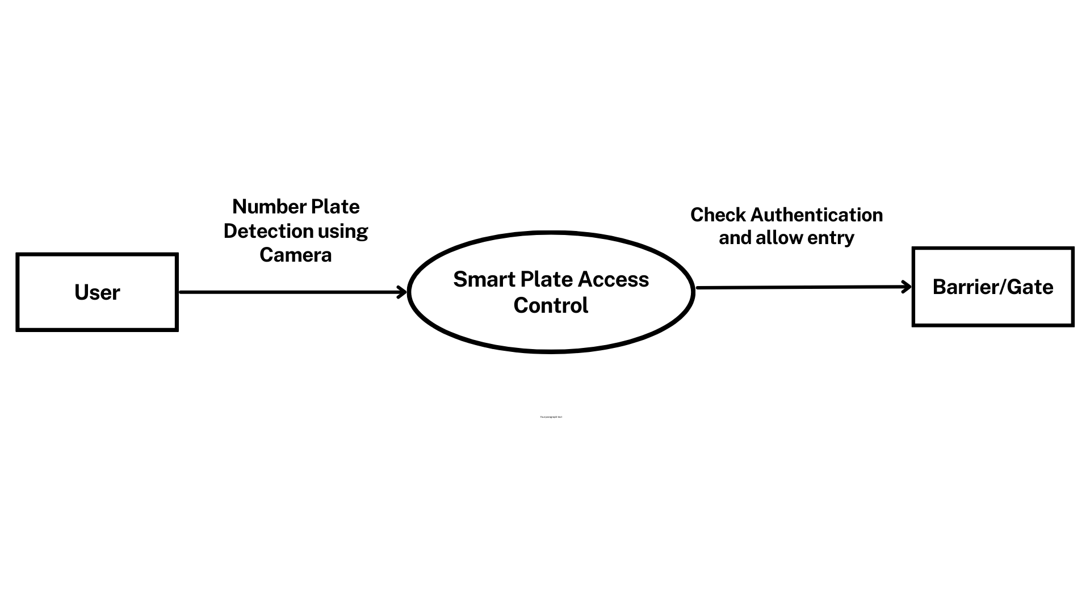
DESIGN
DFD LEVEL 0

Slide 16
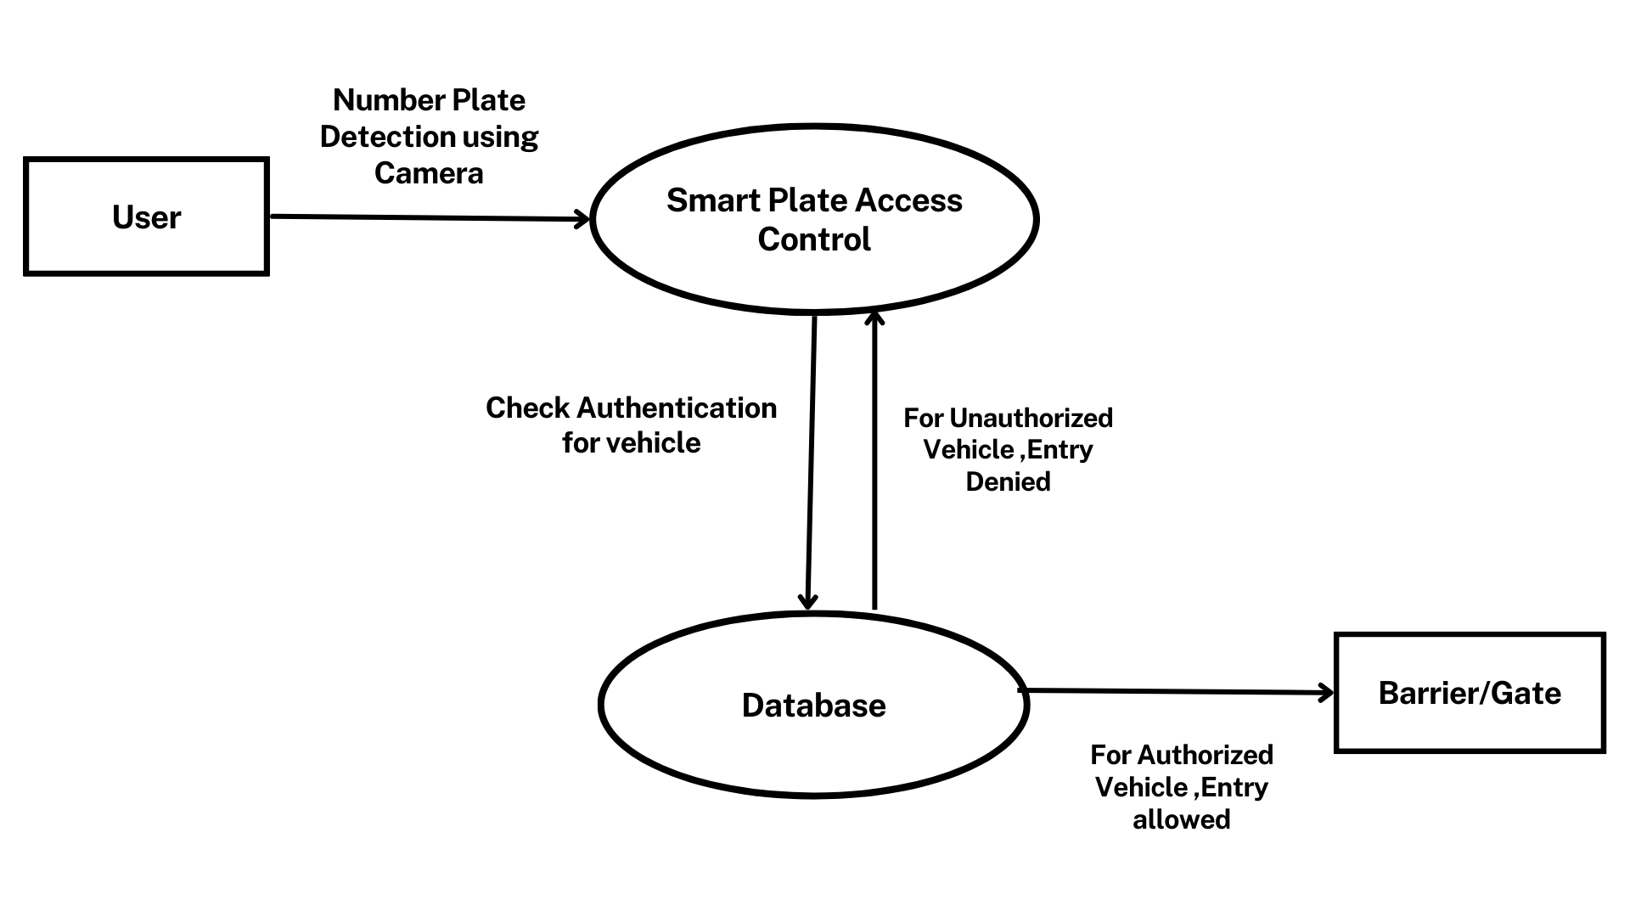
DESIGN
DFD LEVEL 1

Slide 17
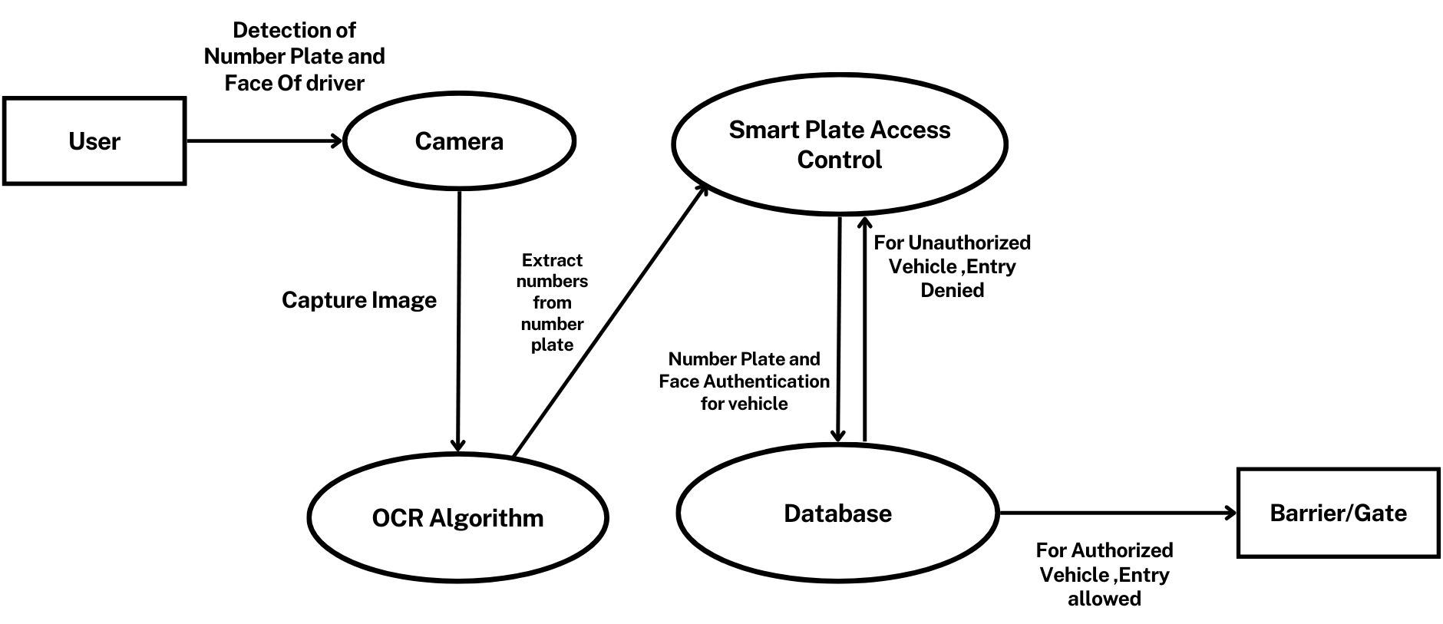
DESIGN
DFD LEVEL 2

Slide 18
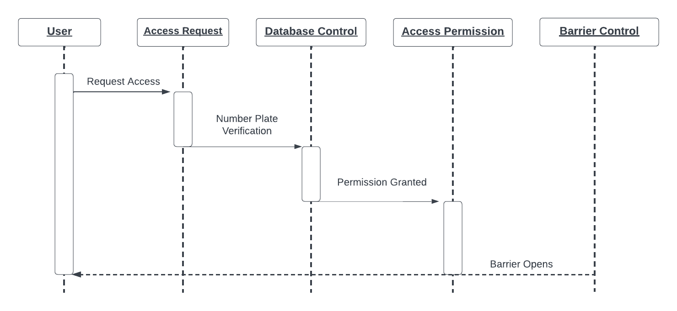
DESIGN
Sequence Diagram

Slide 19
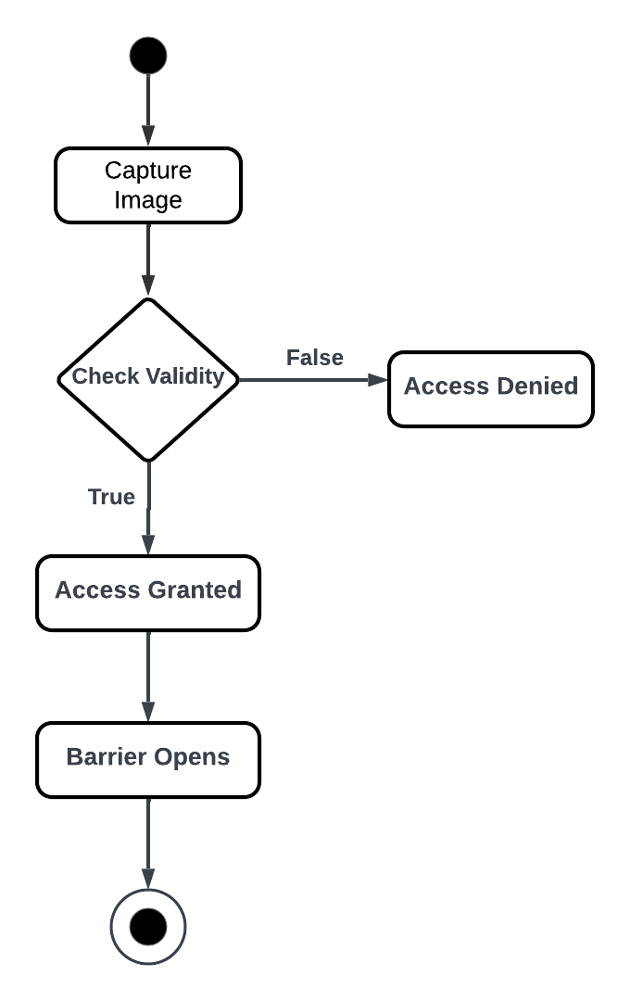
DESIGN
Activity Diagram

Slide 20
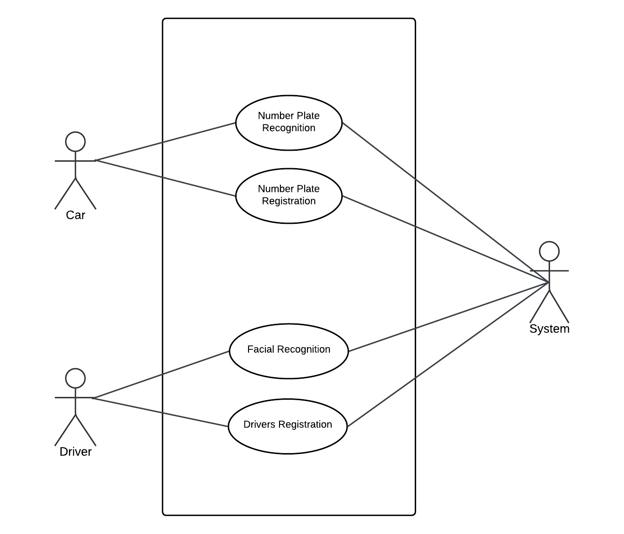
DESIGN
Use Case Diagram

Slide 21
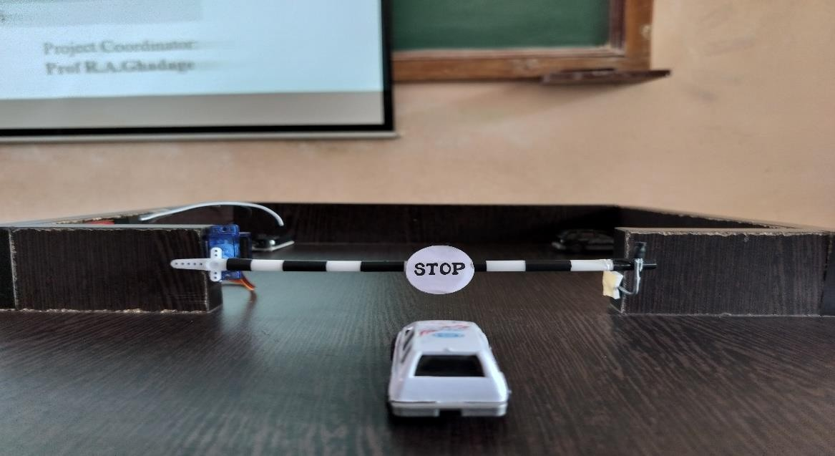
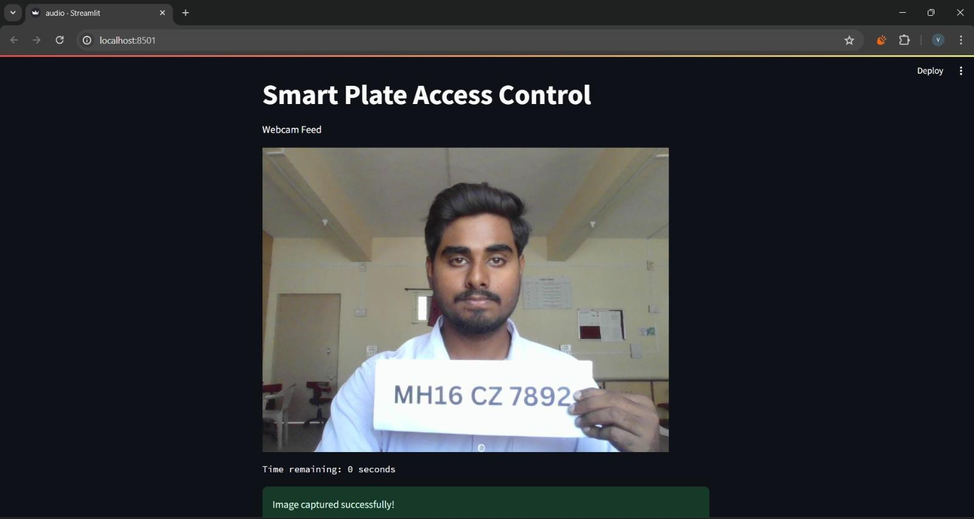
Output

Slide 22
OWN CONTRIBUTION
We are going to make significant contribution to our society by implementing facial recognition technology in Smart Plate Access Control system.
By removing the need for physical access cards or tickets, our system provides a more convenient and modern user experience.
Faster entry processes and reduced queues during peak hours improve user satisfaction.

Slide 23
REFERENCES
“Smart IoT based security system for residence” by Muhhammad Irsyad Haziq, Ilanur Muhanini Binti Mohd Noor, Raed Abdulla.(2022)
“Automatic vehicle Number plate recognition system using ML” by JMSV Ravi Kumar, B Sujatha, N leelavathi.(2021)
“Machine Learning based Number plate detection and recognition” by Zuhaib Ahmed Shaikh, Umair Ali Khan, Muhammad Awais Rajput, Abdul Wahid Memon.(2018)
“Automatic Number Plate Recognition:A Detailed Survey of Relevant Algorithms” by Lubna , Naveed Mufti, and Syed Afaq Ali Shah.(2018)

Slide 24
CONCLUSION
Smart plate access control systems offer a convenient and efficient solution for managing parking facilities. These systems enhance security, reduce manual interventions, and provide a seamless experience for both operators and users. As technology continues to advance, we can expect further improvements in smart plate access control, making it an increasingly integral part of modern parking infrastructure.

